Slide 1
Life cycle method in react

Slide 2
Constructor lifecycle
It is called before render() , therefore calling setState() synchronously in this method will not trigger an extra rendering. Generally, we recommend using the constructor() instead for initializing state. ... This is the only lifecycle method called on server rendering.

Slide 3
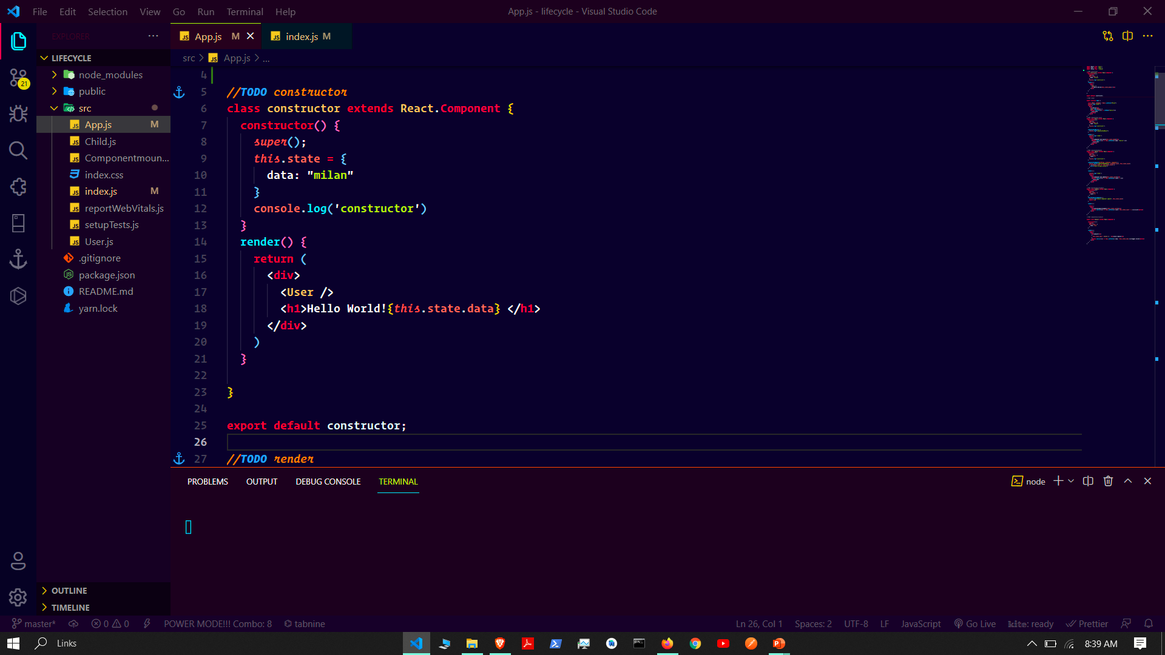

Slide 4


Slide 5
Render life cycle
The render() method is the most used lifecycle method. You will see it in all React classes. This is because render() is the only required method within a class component in React. ... As you can see in the example above, the render() method returns JSX that is displayed in the UI.

Slide 6
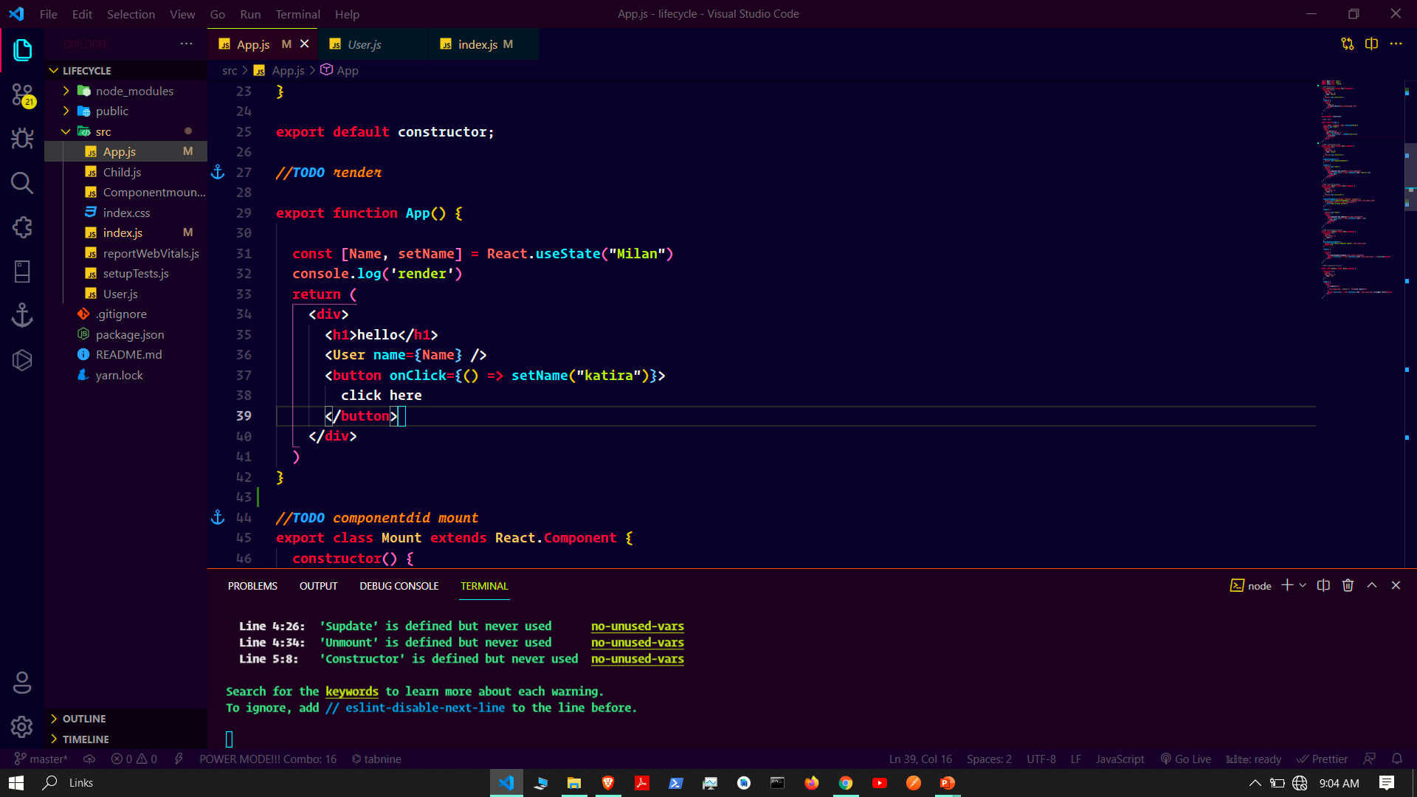

Slide 7
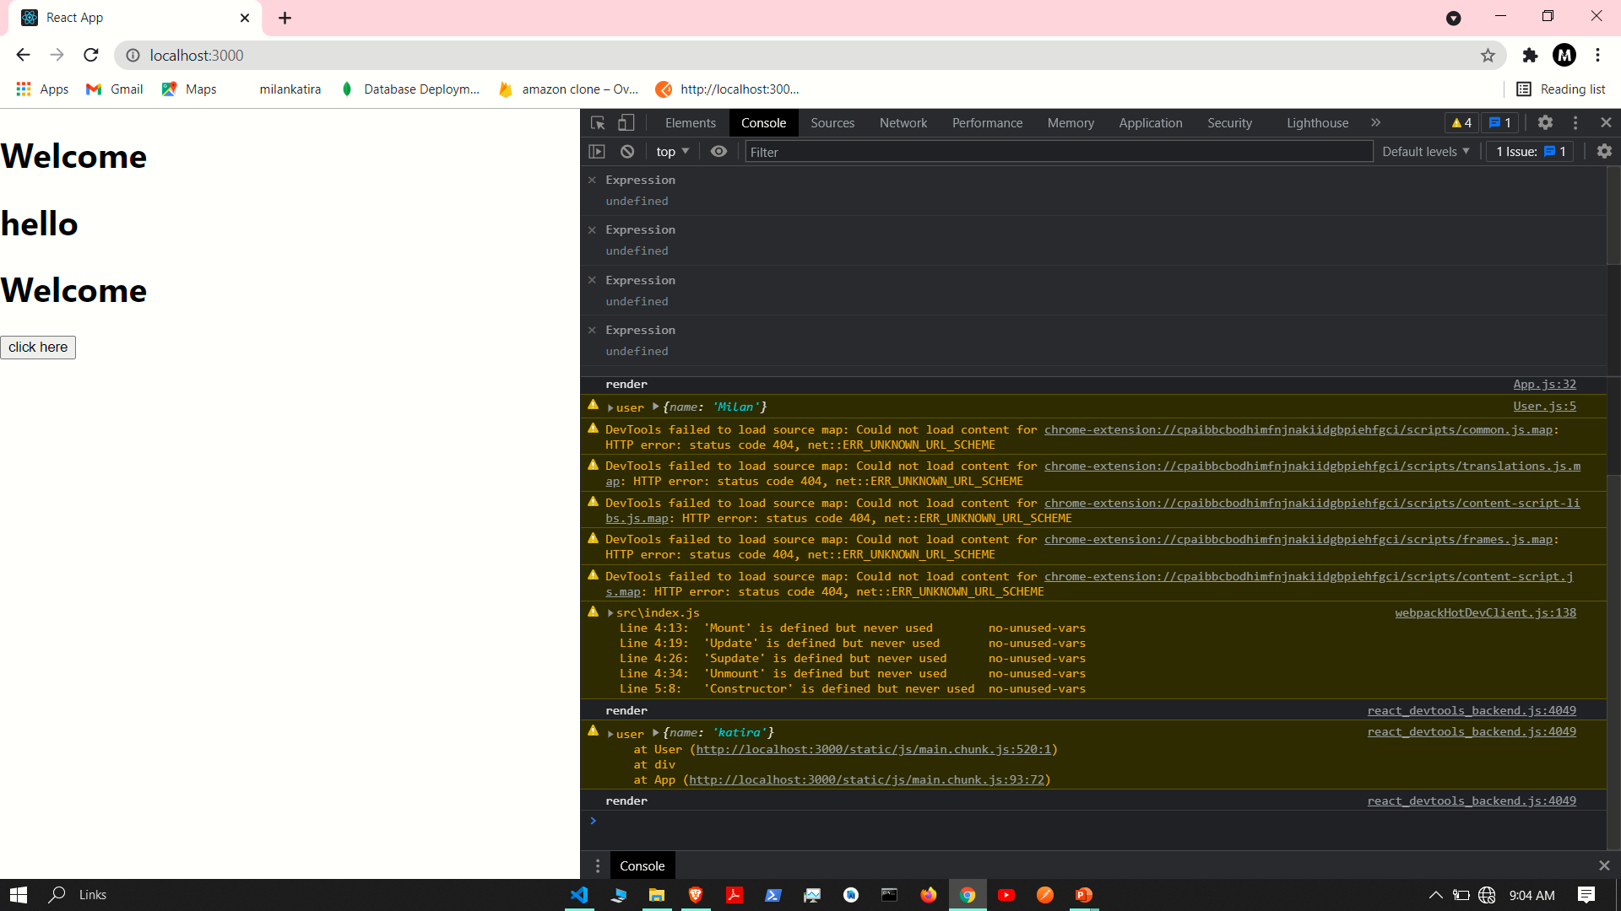

Slide 8
Component did mount
Constructor
Render
Component did mount
It is use for api call

Slide 9
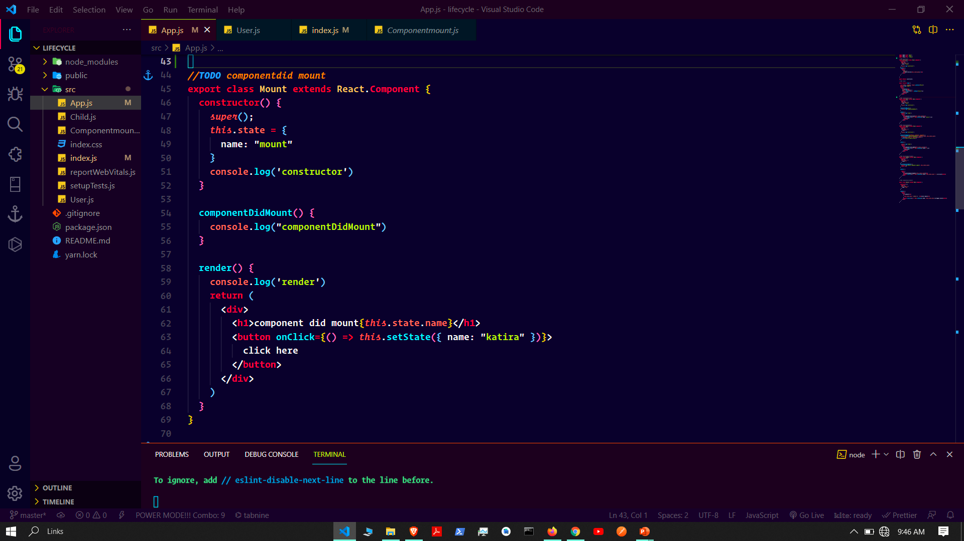

Slide 10
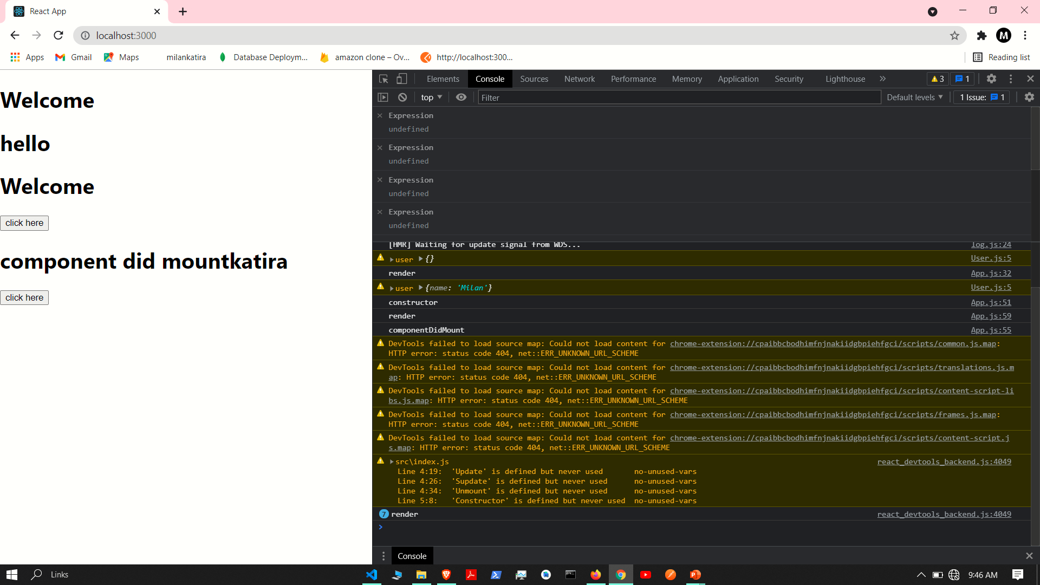

Slide 11
Component did update

Slide 12
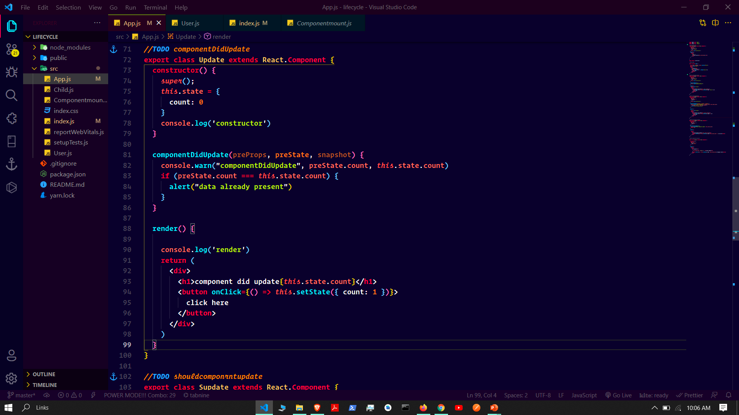

Slide 13
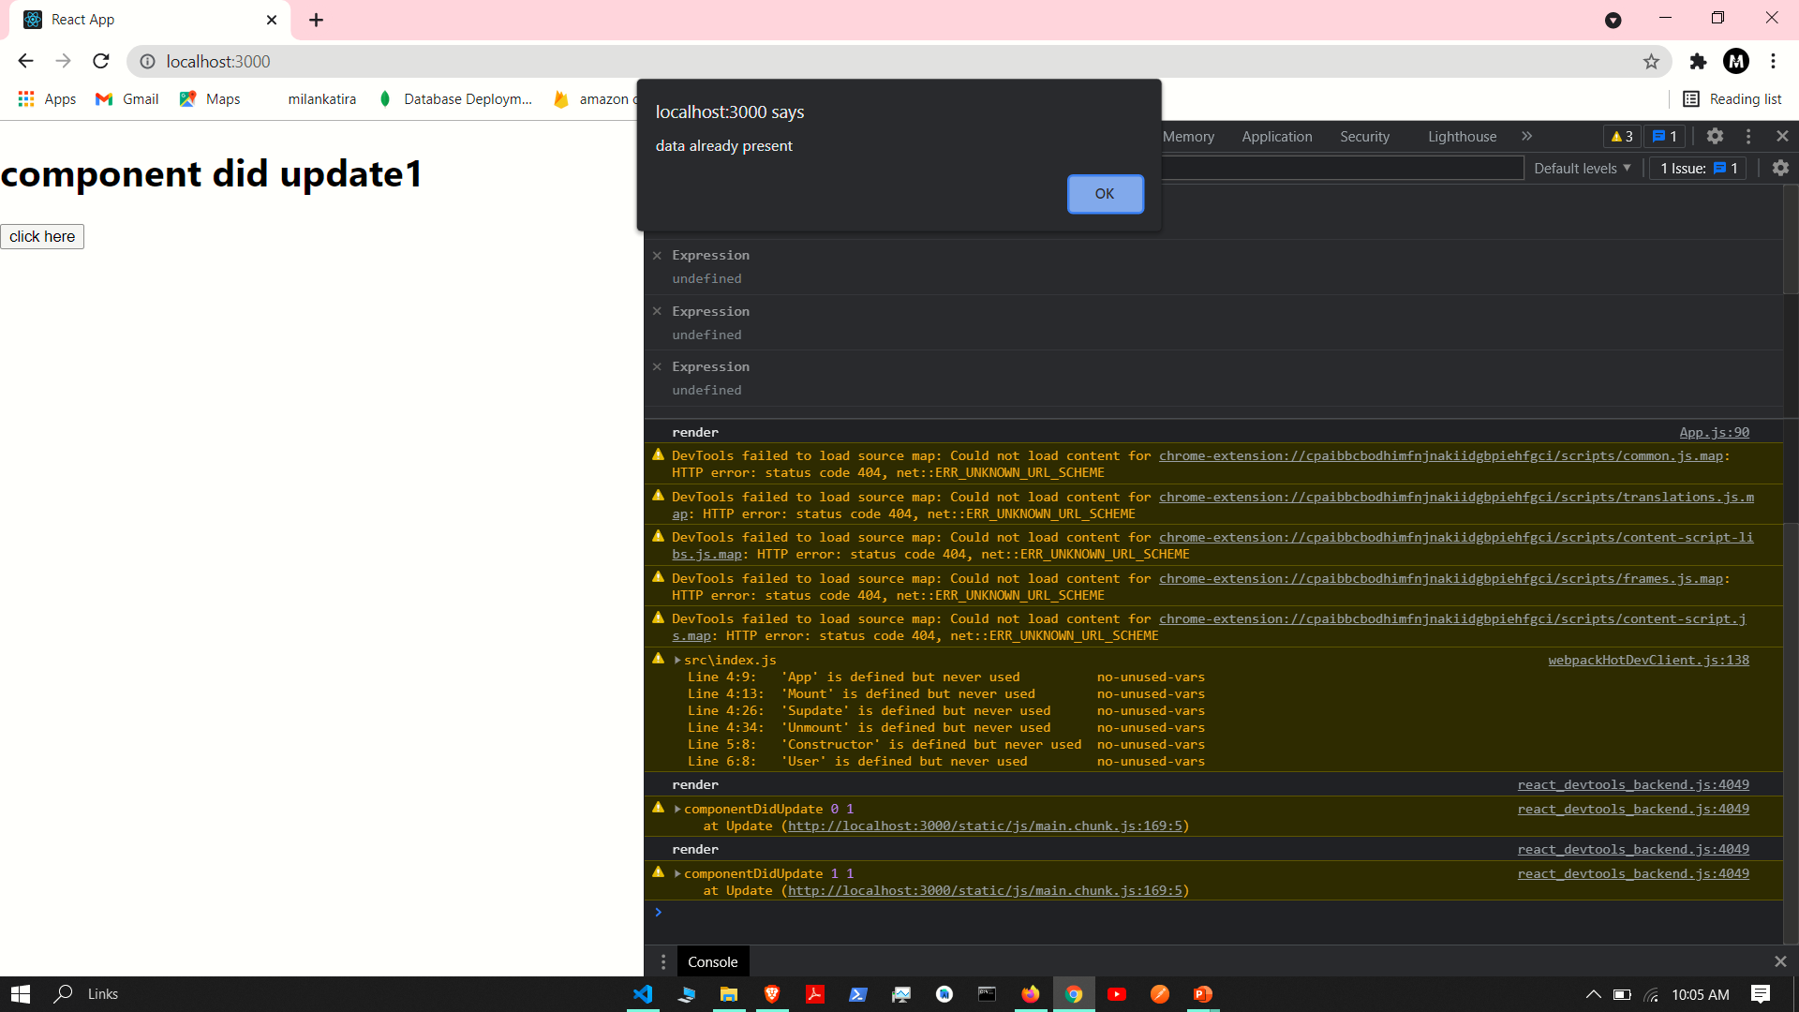

Slide 14
Should component update

Slide 15
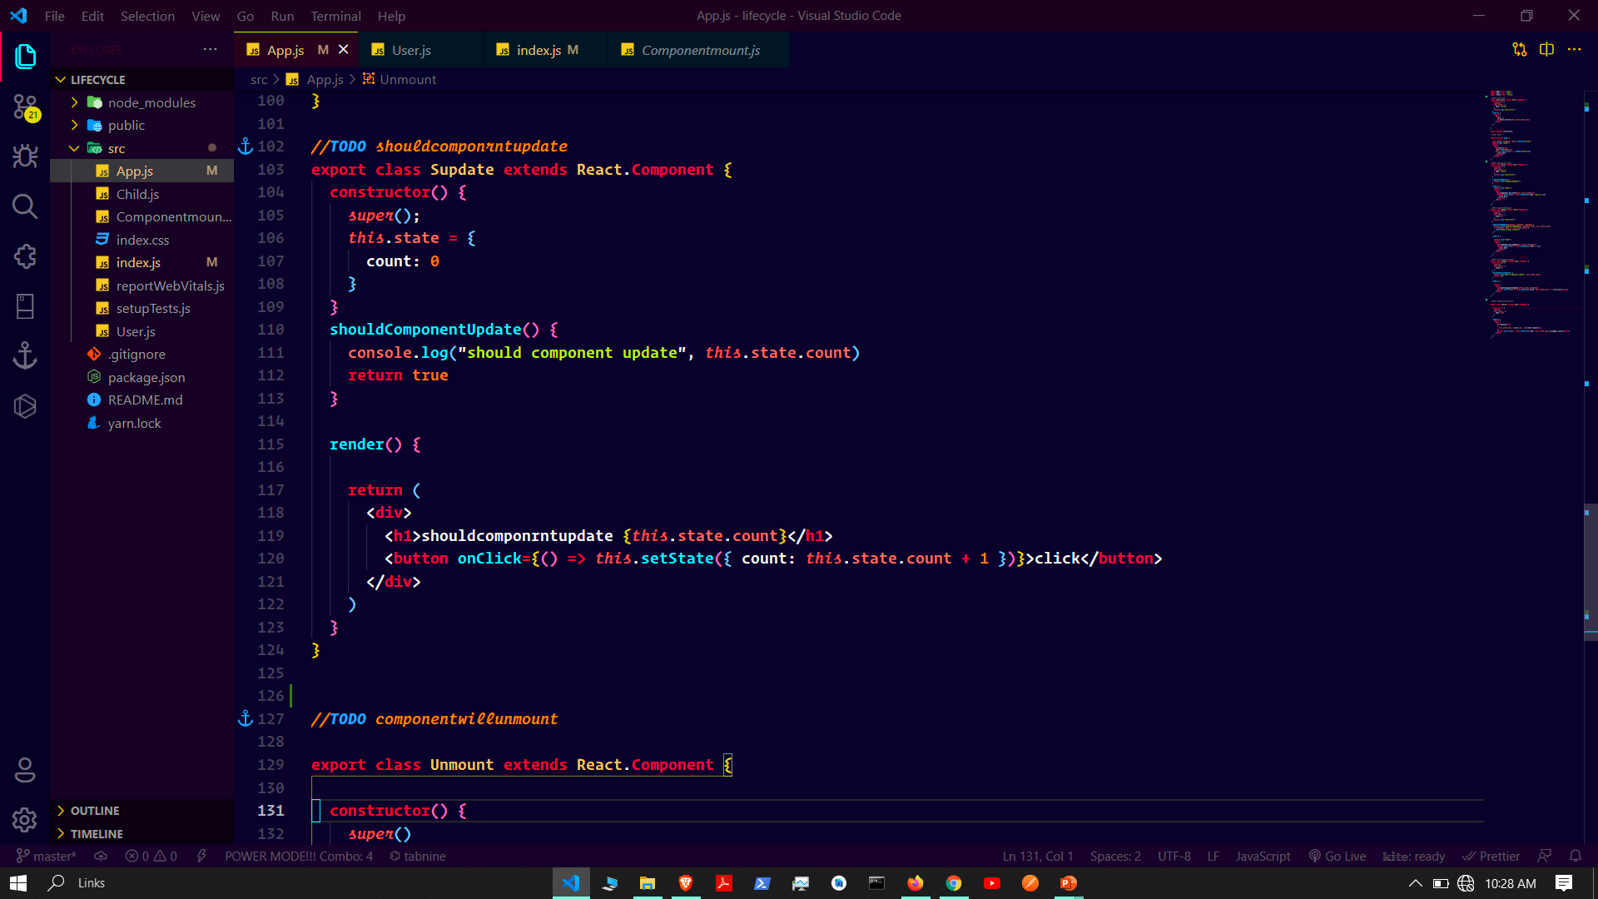

Slide 16
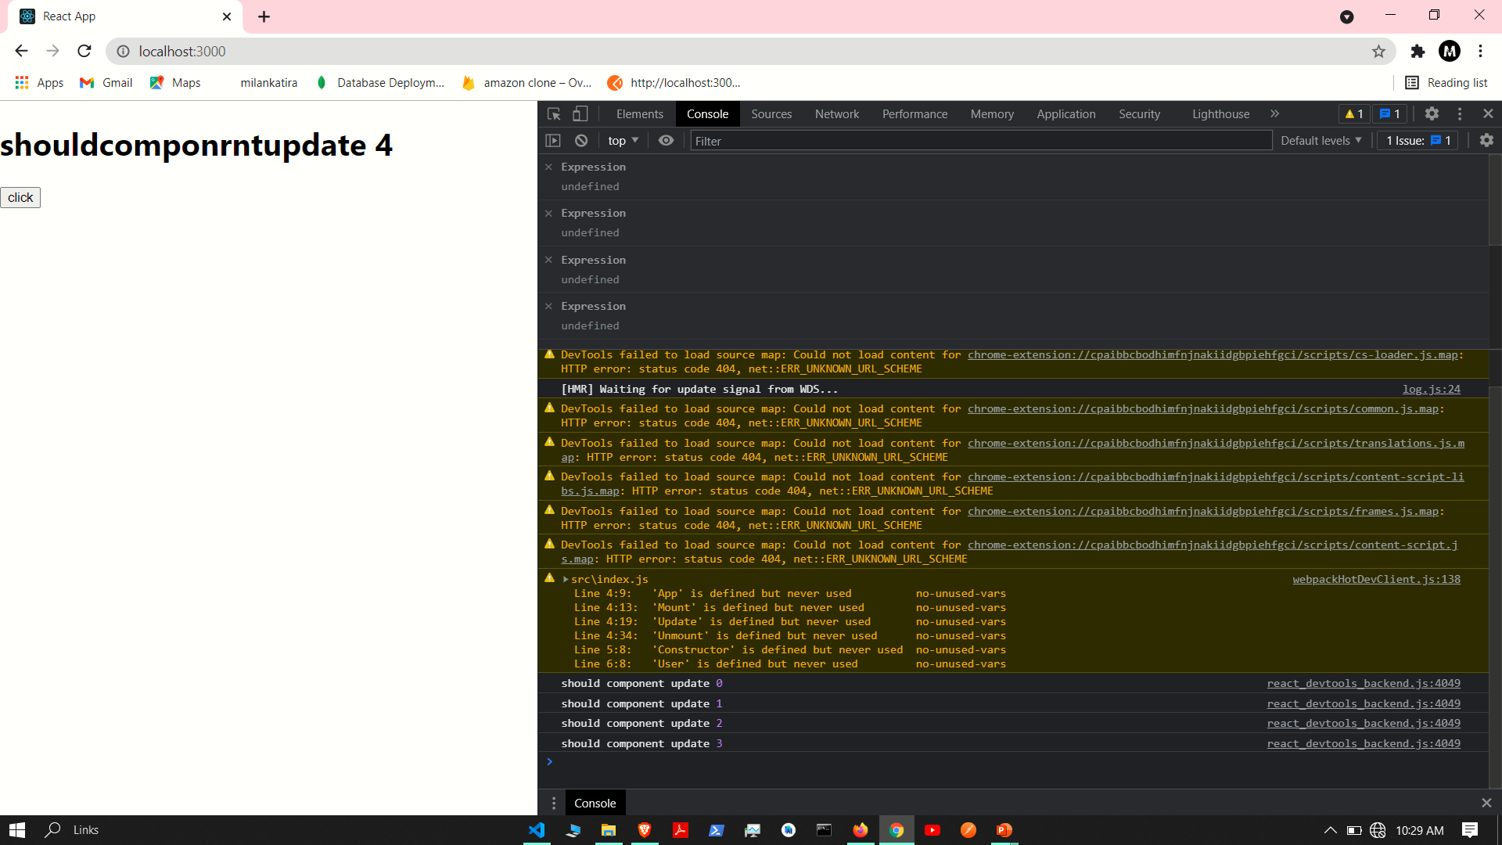

Slide 17
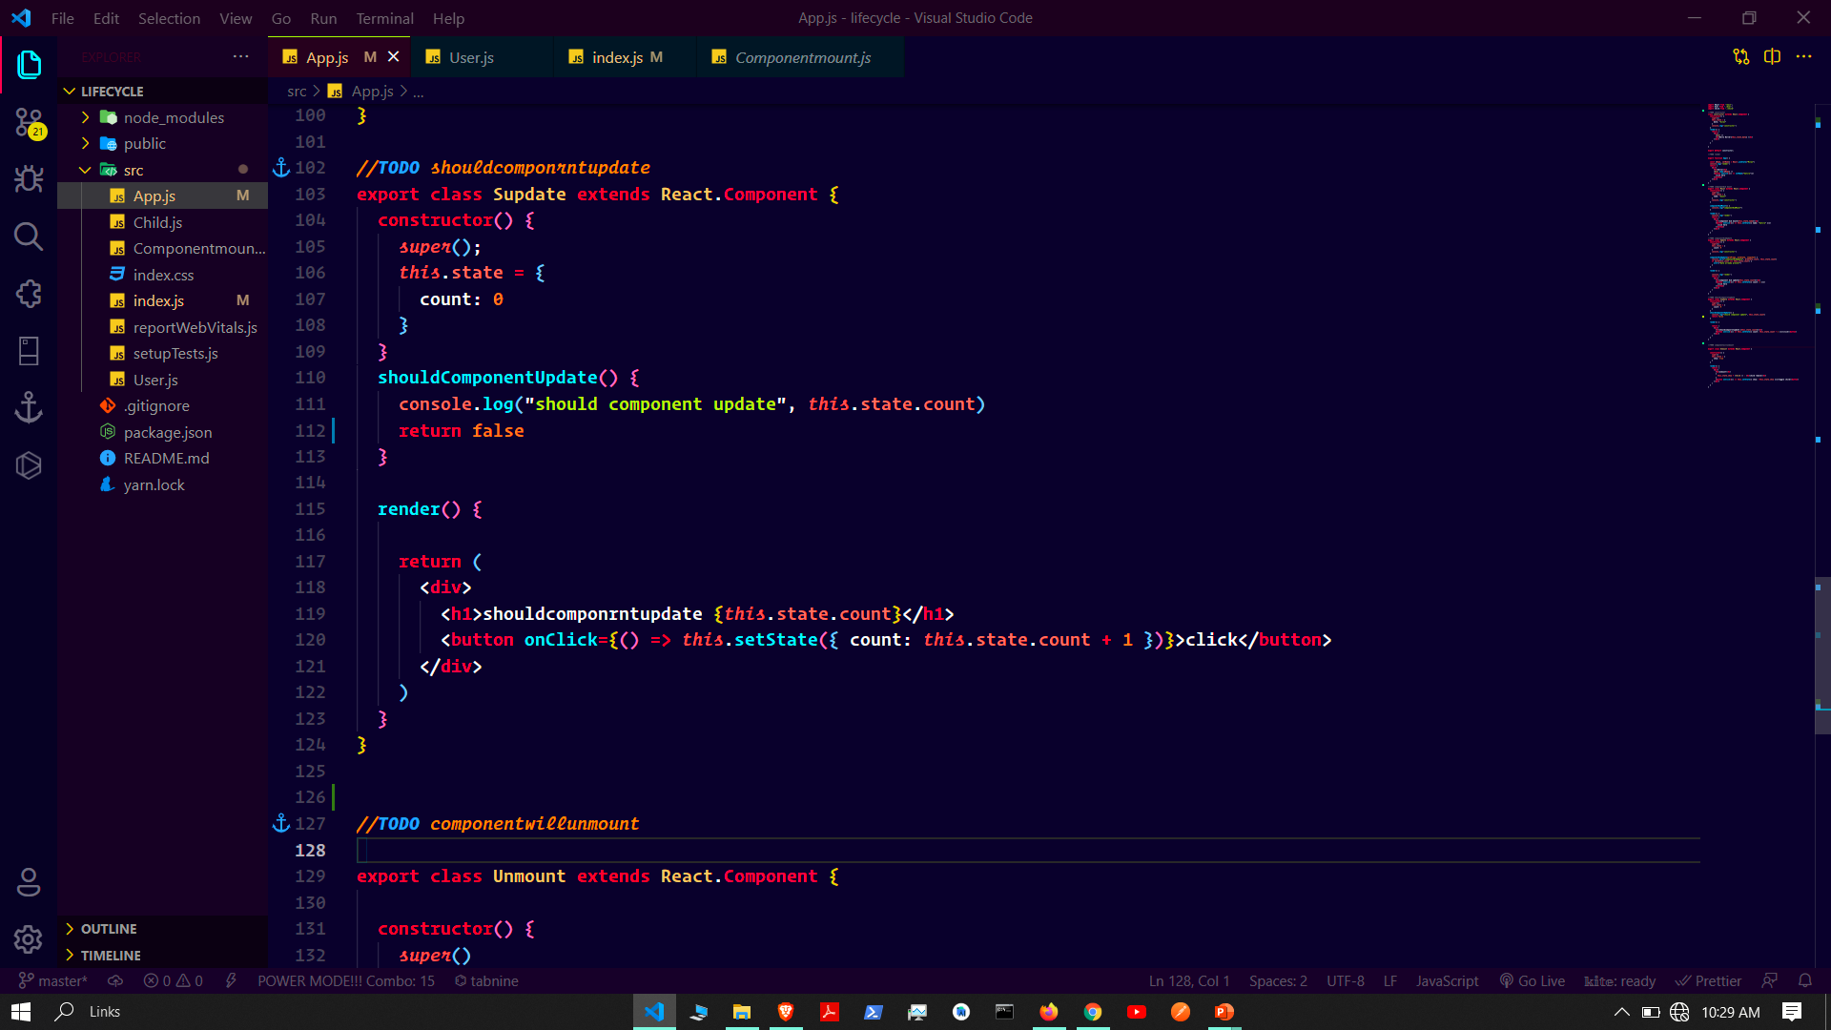

Slide 18
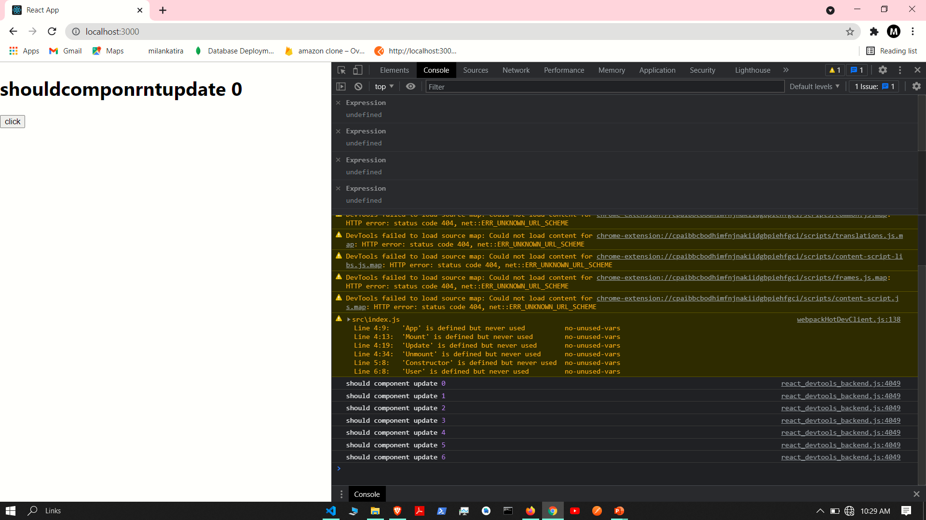

Slide 19
Component will unmount

Slide 20
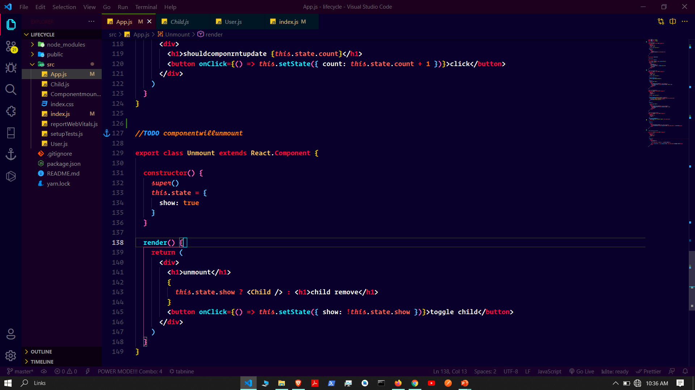

Slide 21
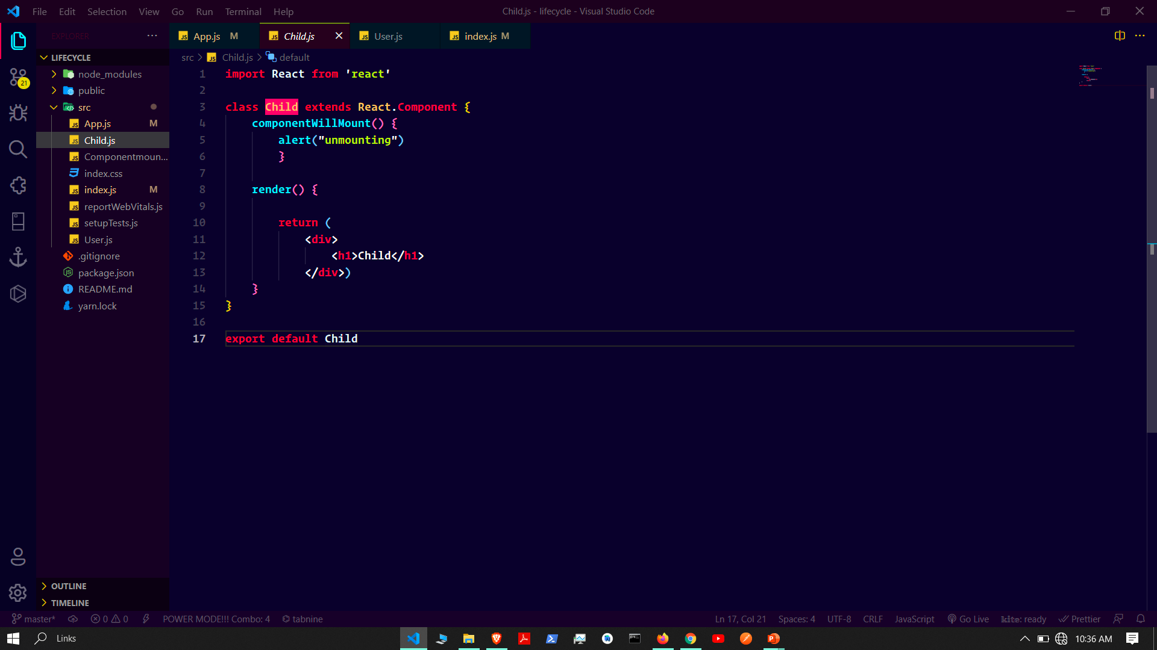

Slide 22
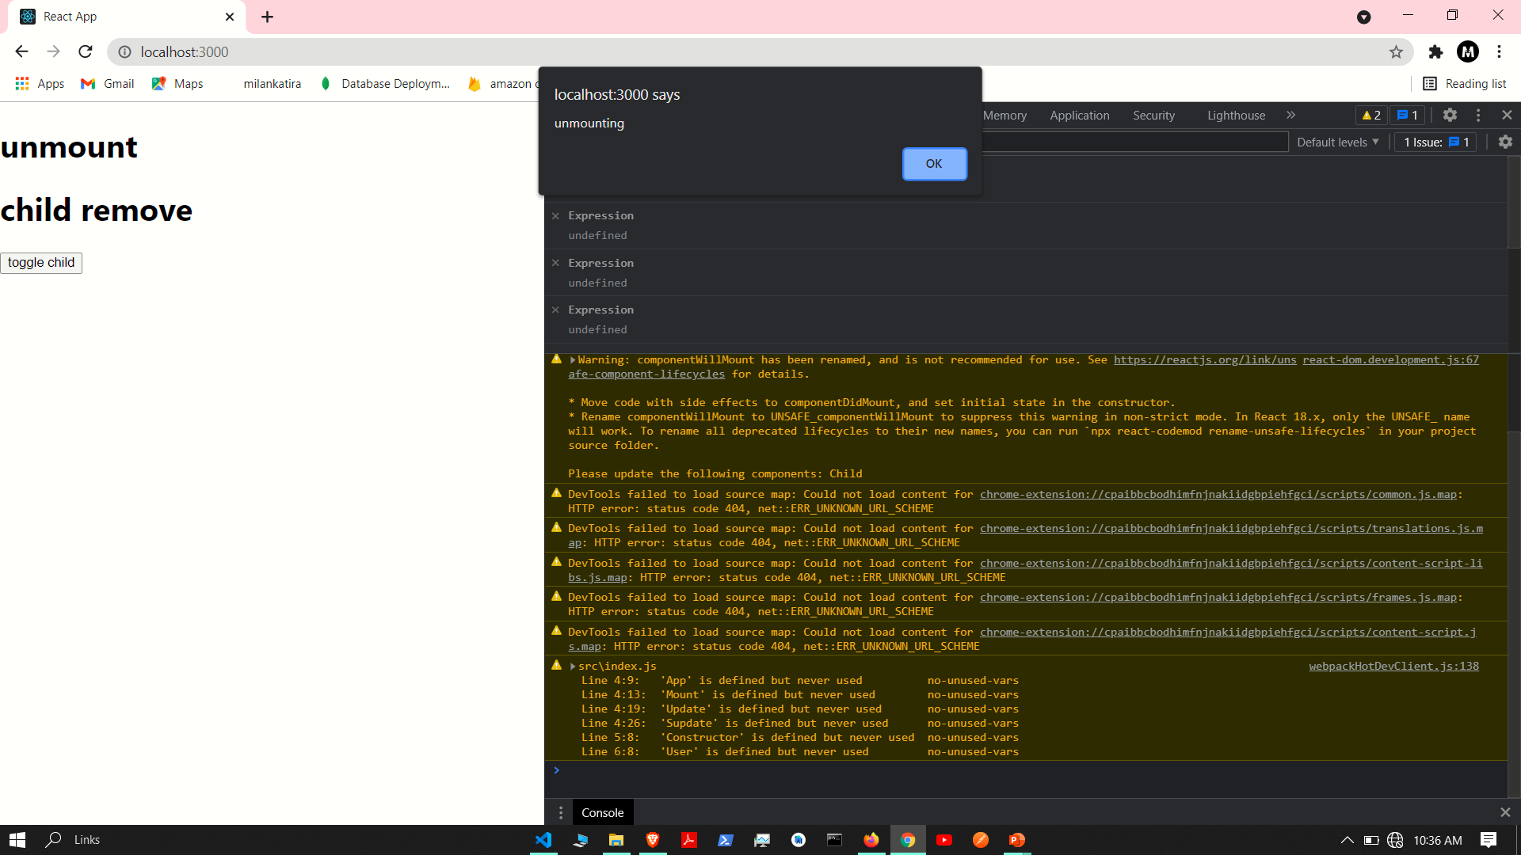

Slide 23


